Slide 1
Bitcoin ….
Mor. Rinat…
git

Slide 2
Bitcoin :
Bitcoin (₿) is a decentralized digital currency, without a central bank or single administrator, that can be sent from user to user on the peer-to-peer bitcoin network without the need for intermediaries The cryptocurrency was invented in 2008 by an unknown person or group of people. The currency began use in 2009 when its implementation was released as open-source software.
Our Research Question is predicting the close rate of Bitcoin currency based on the exchange rate over the years, that have changed, Google searches that day and selected tweets.

Slide 3
Main Steps
Data acquisition - Web crawling and API for collecting and obtaining the data
Data cleaning - Cleaning, formatting, and filtering the data.
EDA - Visualizing and understanding the data
Machine learning – Create final predict model

Slide 4
Data Sources
API
Crawling (selenium)

Slide 5
Crawling
We used selenium tool to crawl the relevant records in the site.
• Finally, the records saved into `df_gfz` dataframe

Slide 7
Not everything was so easy…
At the beginning we tried using ‘Beautiful Soup’ library but we couldn’t get the relevant data because we were dealing with dynamic websites.
We looked for different crawling tool which can deal with dynamic sites. After Research, we decided to use selenium instated.

Slide 8
Selenium
Selenium is an open-source project for a range of tools and libraries aimed at supporting web browser automation. Selenium provides a playback tool for authoring functional tests without the need to learn a test scripting language .
It supports provides all popular programming languages: including JavaScript, C#, Groovy, Java, Perl, PHP, Python.
The tests can then run against most modern web browsers.
Selenium runs on Windows, Linux, and macOS. It is open-source software released under the Apache License 2.0.
We used in our project python and chrome browser.

Slide 9
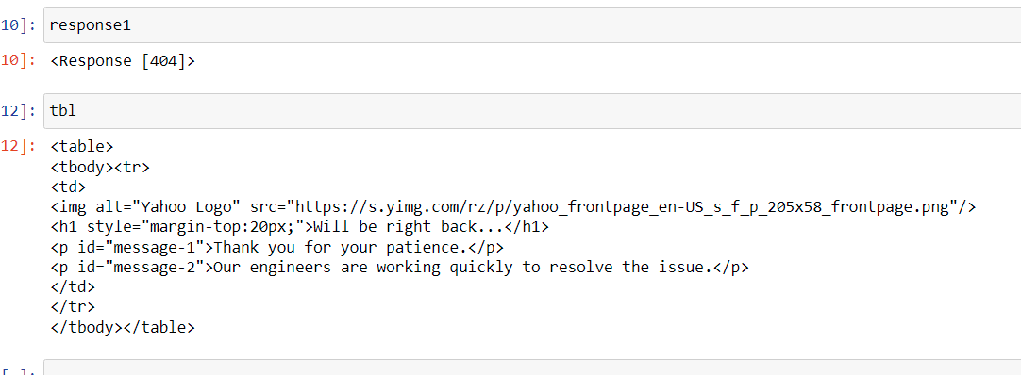
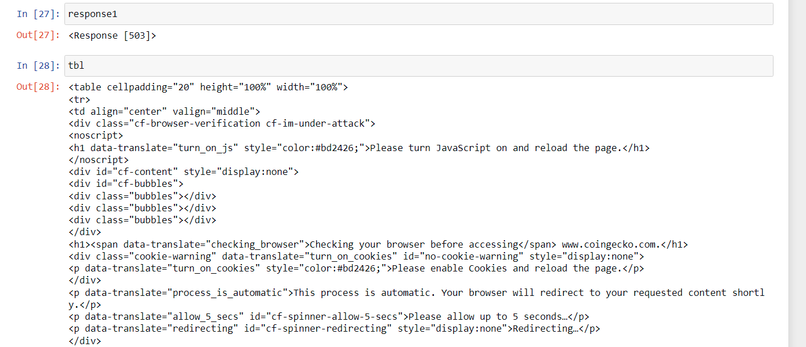

Slide 10
Cleaning the data
Change
Outliers
Date
Categorially to int “Up|Down”
Null

Slide 11
Exploratory data analysis

